Slide 1
Literary Terms for Short Story Unit
By Stacie Kaminski

Slide 2
SETTING: time and place of a story
Establishes mood
Can be source of conflict (person vs. nature)
Illuminates the character (reveals strengths and weaknesses)
Helps make fiction believable

Slide 3
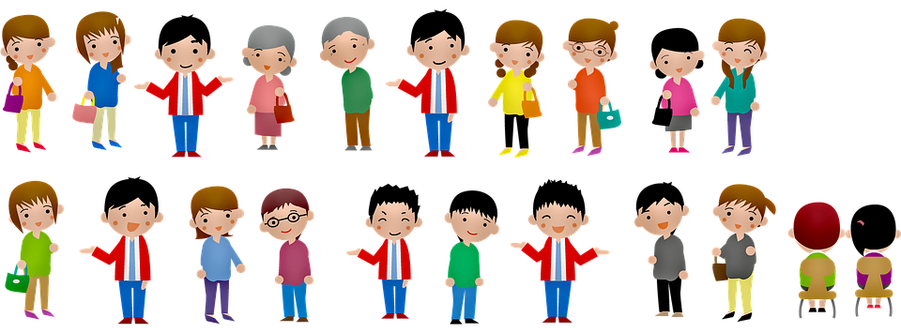
Characterization
Direct characterization - author TELLS us what the character is like
Indirect characterization - reader figures out what a character is like by what the character says, thinks, and does as well as what other say about him / her and how he / she looks

Slide 4
DENOTATION
The objective dictionary definition of a word.
Frugal and cheap mean the same but one is more positive.

Slide 5
CONNOTATION
The meaning, association, or emotion that a word suggests
Robust vs. Fat
Assertive vs. Bossy

Slide 6
ALLUSION (NOT allusion)
A literary reference to something that the writer assumes the reader will be familiar with such as the Bible, Shakespeare, or mythology
Sam was like the little boy who cried wolf.

Slide 7
PLOT
A series of events that make up a story

Slide 8
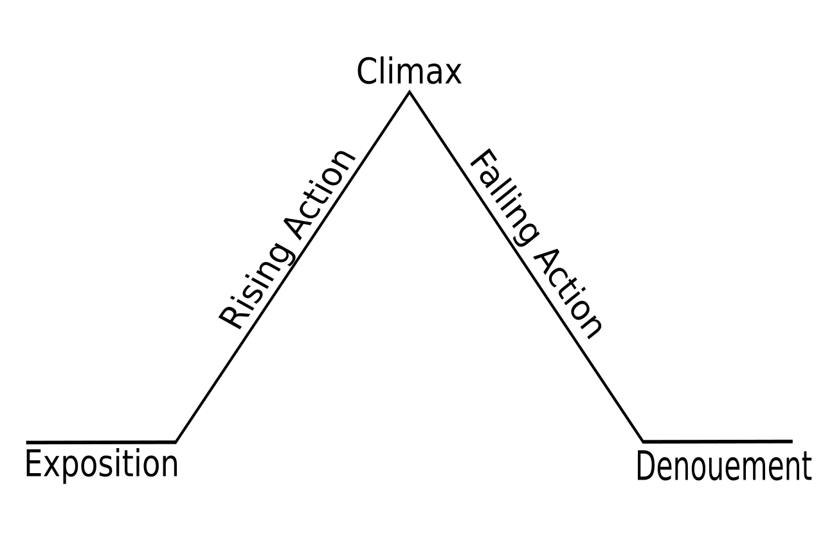
Parts of a Story
Exposition - introduces the setting, character and conflicts
Rising Action - Complications to the problem - challenges for characters
Climax - crisis / turn point / high point (more on this on the next slide)
Falling Action - follows the climax, answers questions
Resolution - conflict is resolved and ends

Slide 9
CLIMAX
The turning point / crisis or the moment of greatest intensity which occurs near the end of story which helps determine the outcome of the conflict
It is often marked by a significant action, even a moment of violence.
In Romeo and Juliet the climax comes right before they both kill themselves.

Slide 10
SYMBOL
Person, place, thing, or event that stands for both itself and for something else
Apple—education
Rainbow—hope
Black cat—bad luck

Slide 11
FORESHADOWING
The use of clues to hint at events that will occur later in the plot
In Romeo and Juliet Romeo’s death is foreshadowed when he says he had a dream that he died an untimely death.

Slide 12
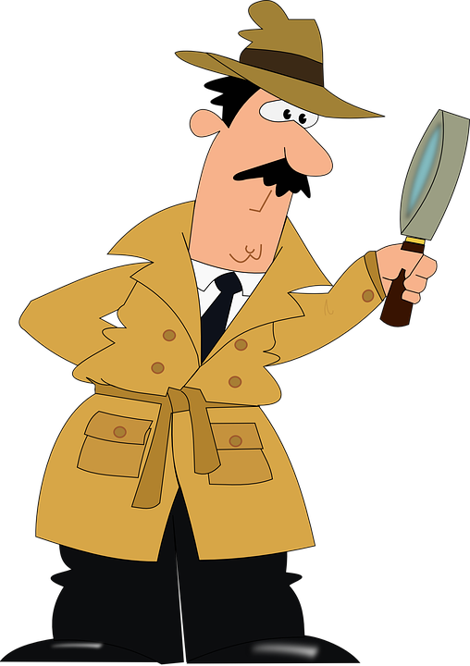
INFERENCES
Something that is not directly stated but is hinted at or revealed indirectly - based on hints or clues
Inferences focus the present where foreshadowing gives hints or clues about the future.
In Make Lemonade it says Jolly’s door has three locks on it. This hints that it is a high crime neighborhood.

Slide 13
CONFLICT
The struggle between two opposing forces which can be internal or external
PERSON vs. PERSON (Tim insults Mary)
PERSON vs. SELF (internal conflict—should I stay out late?)

Slide 14
CONFLICTS CONT.
PERSON vs. NATURE (blizzard when driving home)
PERSON VS. SOCIETY (school system, legal system, etc.)

Slide 15
IMAGERY
Language which appeals to the senses as it describes the sights, sounds, textures, and smells in the story – creating a picture w/ words
“He would tell his mother how it smelled: mud and algae and cattle manure and chlorophyll…”

Slide 16
THEME
The central idea or insight revealed by the story - expression about point of view of life
It is a general lesson we can apply to our own lives. Sometimes it is revealed through mistakes of the characters.
R&J: Don’t act impulsively.
Themes are stated in general terms and don’t mention characters’ names or actions.

Slide 17
IRONY
The contrast or difference between expectations and reality—may be verbal (things said), situational (things that occur), etc. Note paradox and oxymoron are sisters to irony
The president of MADD gets arrested for drunk driving.
A tornado strikes an outdoor theater when the movie Twister is playing.

Slide 18
PROTAGONIST
the main character in a piece of fiction which is involved in the main conflict
Odysseus from The Odyssey is a protagonist.

Slide 19
ANTAGONIST
The character or force that comes into conflict with the protagonist.
The protagonist is rarely all good and the antagonist is rarely all bad.
Tybalt is an antagonist in Romeo and Juliet.

Slide 20
ANTONYM
Words that have opposite meanings
Kind, Cruel
Healthy, Sick
Generous, Greedy

Slide 21
SYNONYM
Words that have similar meanings
Loving, Caring
Satisfied, Fulfilled
Deceitful, Untruthful

Slide 22
POINT OF VIEW
The vantage point from which the story is being told
FIRST PERSON (I made the winning shot.)
THIRD PERSON (Matt made the winning shot.) Narrator outside the story but can NOT “see” into the minds of the characters
OMNISCIENT–all knowing so it can reveal inner thoughts, feelings (Matt was nervous as he released the basketball.)

Slide 23
ONOMATOPOEIA
The use of words whose sounds imitate their meaning
Drip, gurgle, bang, buzz, honk
Snap, crackle, pop, thud, sizzle

Slide 24
SIMILE
A comparison between two unlike things using like or as
The slowly moving and ever changing clouds were like a giant lava lamp in the sky.

Slide 25
METAPHOR
Comparing two unlike things saying that one thing literally is something else
Her positive attitude was a refreshing rain which rejuvenated everyone in her presence.
She lifted her concrete hands as she wearily finished the task.

Slide 26
ALLITERATION
The repetition of the same sound at the beginning of the word
long lost love
Her sweet smile made my heart swell.

Slide 27
PERSONIFICATION
Giving human like characteristics to animals or non-living things.
The leaves danced in the wind.
The birds gossiped in the morning air.

